Slide 1
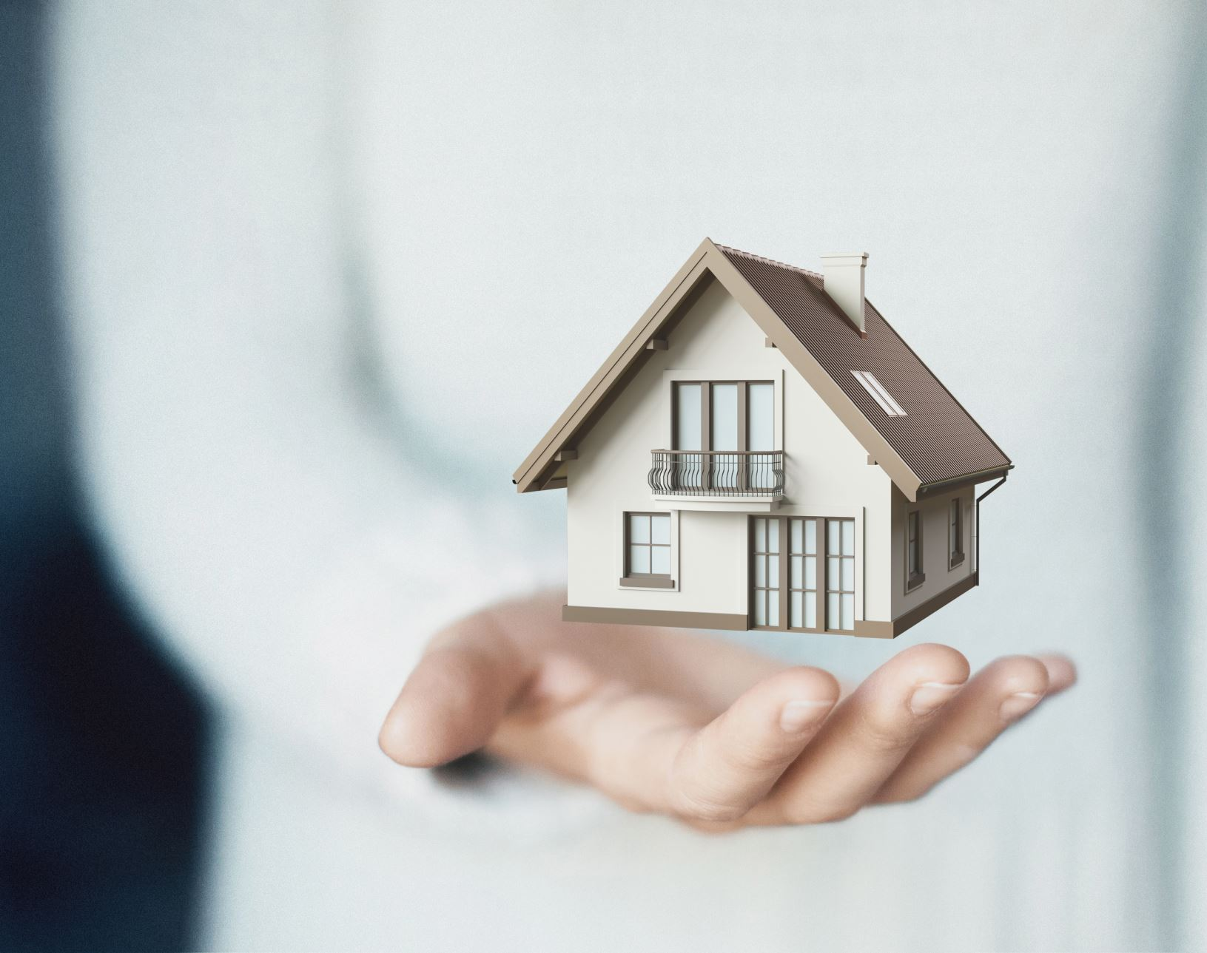
APPLICATION OF BLOCKCHAIN IN REAL ESTATE

Slide 2
CONTENTS AND OUTLINES
1. Introduction
2. Four Case Studies Table (Sr no., Title, Overview, Link)
3. Motivation
4. Architectural flow diagram
5. Implementation
6. Conclusion
7. Reference

Slide 3
INTRODUCTION
What is blockchain and its fundamental characteristics
Potential applications in various industries
Applying blockchain in the real estate sector

Slide 4
WHAT IS BLOCKCHAIN?
Blockchain is a decentralized and distributed digital ledger technology that enables secure and transparent recording of transactions across multiple participants in a network. It serves as a tamper-resistant and immutable record of data, providing a trustless environment for various applications

Slide 5
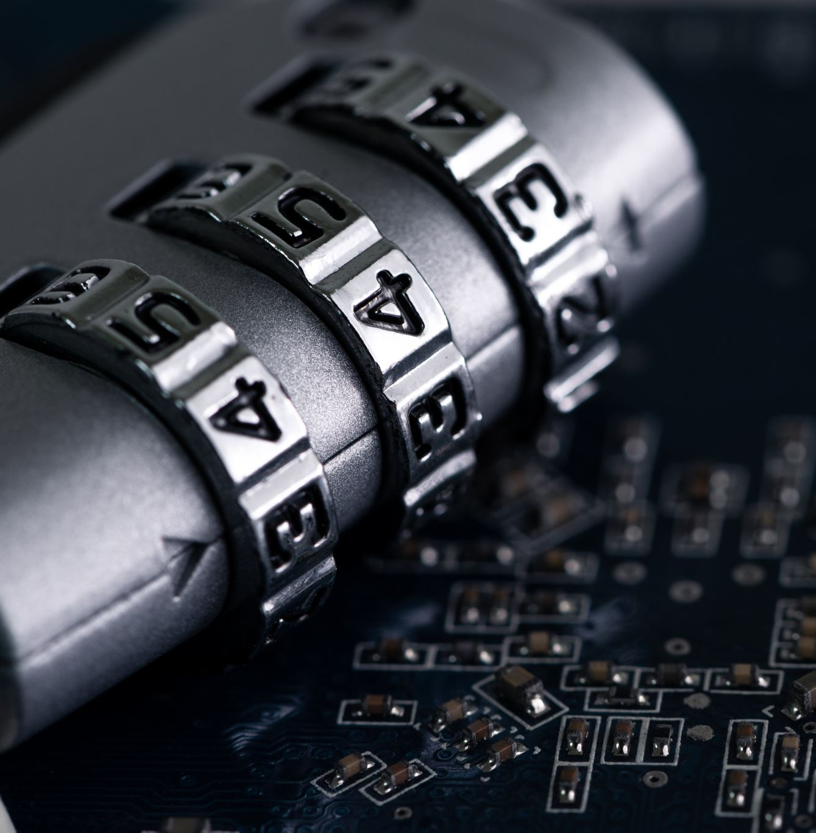
THE FUNDAMENTAL CHARACTERISTICS OF BLOCKCHAIN
Decentralization: No central authority, peer-to-peer network.
Transparency: All transactions visible to all participants.
Security: Cryptography ensures integrity and authenticity.
Immutability: Recorded data cannot be modified or deleted.
Consensus Mechanisms: Agreement among participants.
Smart Contracts: Self-executing contracts with predefined rules.
Efficiency and Speed: Improving scalability and transaction processing.

Slide 6
POTENTIAL APPLICATIONS IN VARIOUS INDUSTRIES
Finance: Secure and transparent transactions, cross-border payments, and reducing fraud.
Supply Chain: Tracking products, verifying authenticity, and improving traceability.
Healthcare: Securing medical records, managing patient data, and enhancing interoperability.
Voting: Ensuring transparent and tamper-resistant voting systems.
Gaming: Creating digital assets, enabling ownership, and enhancing in-game economies.
Intellectual Property: Protecting copyrights, patents, and digital content ownership.
Identity Management: Securing identity data, enabling self-sovereign identity.
Energy: Enabling peer-to-peer energy trading and optimizing energy grids.
Real Estate: Streamlining property transactions, title management, and ownership records.
Government: Improving public service delivery, reducing corruption, and enhancing transparency.

Slide 7
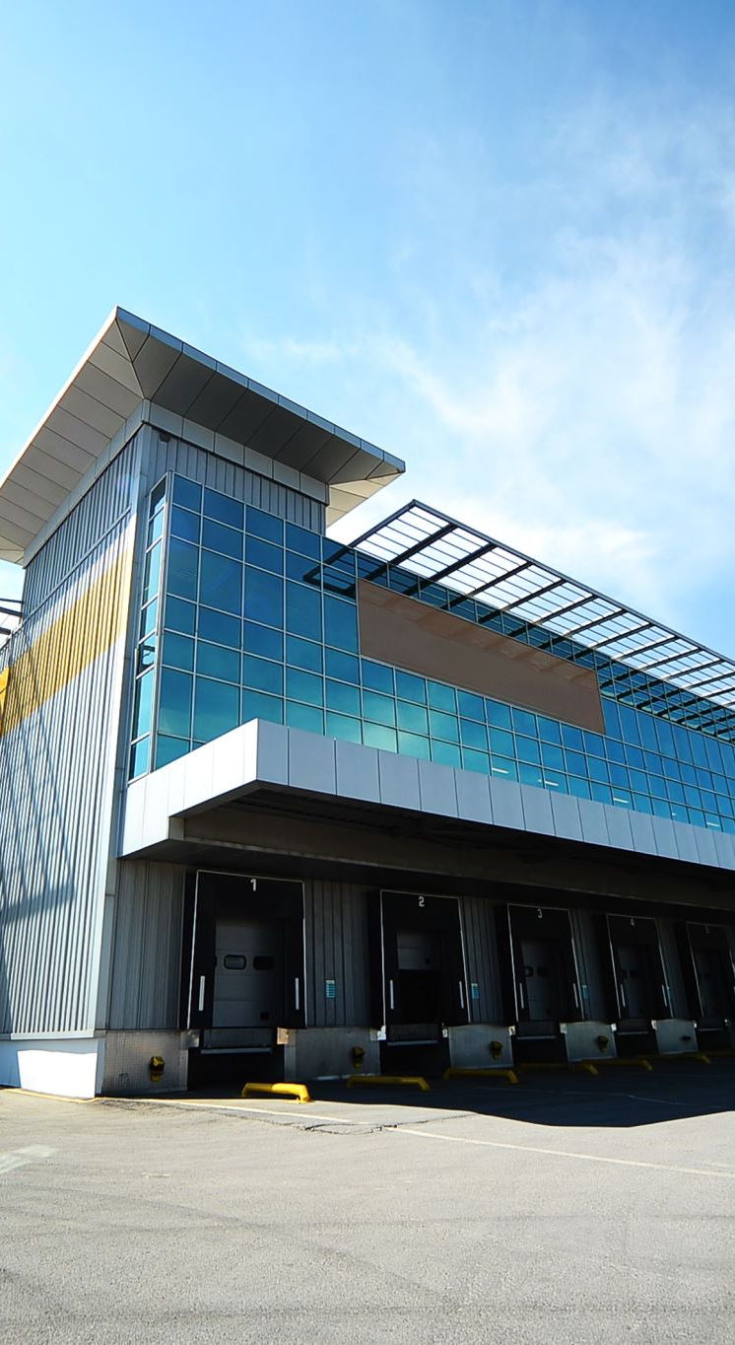
APPLYING BLOCKCHAIN IN THE REAL ESTATE SECTOR
Applying blockchain in the real estate sector involves leveraging the unique characteristics of blockchain technology to revolutionize traditional processes and address challenges in the industry. By introducing transparency, security, and efficiency, blockchain has the potential to transform various aspects of real estate transactions, property management, and ownership records.
Blockchain can enhance transparency by providing a decentralized and immutable ledger where all transactions and property-related data can be recorded. This transparency reduces the risk of fraud, as all participants have access to the same information and can verify the authenticity of property records and ownership details.
The security aspect of blockchain ensures that property records are tamper-proof and cannot be easily altered or manipulated. The use of cryptographic techniques and distributed consensus mechanisms ensures the integrity and authenticity of data, providing a trusted environment for real estate transactions.

Slide 8
APPLYING BLOCKCHAIN IN THE REAL ESTATE SECTOR
Moreover, blockchain can streamline and automate the complex processes involved in property transactions, such as title transfers, contract management, and escrow services. Smart contracts, built on blockchain, enable self-executing agreements with predefined conditions, automating the transfer of ownership and ensuring compliance with contractual terms.
Additionally, blockchain-based solutions can address challenges related to property ownership records. By digitizing and storing property titles on the blockchain, the risk of fraudulent claims, disputes, and discrepancies can be minimized. Blockchain-based land registries can provide a transparent and easily accessible source of ownership records, simplifying the due diligence process for buyers and lenders.
Overall, applying blockchain in the real estate sector has the potential to streamline processes, enhance transparency, reduce fraud, and increase efficiency. It can bring significant benefits to all stakeholders involved in real estate transactions, including buyers, sellers, real estate agents, lenders, and government authorities.

Slide 9
CASE STUDIES ON BLOCKCHAIN USE CASES
IN THE REAL ESTATE INDUSTRY
Sr No. | Title | Overview | Link
1. | The Real Estate Tokenization | One of the most popular uses of blockchain in real estate is tokenization. Tokens represent a particular number of shares for some real estate assets that can be issued, bought, and sold through blockchain platforms with cryptocurrency. It speeds up property sales and lowers crowdfunding barriers. | https://consensys.net/blockchain-use-cases/finance/hmlr/
2. | Smart Contracts | The blockchain uses in real estate can also be with the help of smart contracts. Smart contracts, which are incredibly beneficial for the banking and finance sectors, are among the most profitable blockchain innovations. The real estate industry, which must handle numerous transactions, might also incrementally gain from this technology. | https://lnu.diva-portal.org/smash/get/diva2:1615719/FULLTEXT01.pdf
3. | Security and Control Over Transactions | Blockchain use cases in real estate can also lead to a reduced risk of fraud. You might be dealing with someone trying to buy property from you, or you are attempting to buy it from them. You don’t know them, and therefore there is no reason for you to trust them implicitly. With blockchain tech, you don’t have to. Property transactions no longer have to go through third parties because blockchain eliminates the possibility of anything underhanded. | https://www.researchgate.net/publication/348531226_A_Blockchain_Solution_for_Securing_Real_Property_Transactions_A_Case_Study_for_Serbia
4. | Property Management Automation | The use of blockchain technology in real estate will eliminate manual paperwork and the need to use multiple software programs. All of that will be replaced by blockchain tech for betterment and up-gradation. A single decentralized application with blockchain-backed smart contracts will make the whole property management process efficient. It will lead to reduced costs and time spent on administrative tasks. | https://www.emerald.com/insight/content/doi/10.1108/PM-05-2021-0031/full/html

Slide 10
MOTIVATION
Challenges in the current real estate industry
How blockchain can address these challenges
Potential benefits of using blockchain in real estate

Slide 11
CHALLENGES IN THE CURRENT REAL ESTATE INDUSTRY
Lack of Transparency: Real estate transactions often lack transparency, making it difficult for buyers, sellers, and other stakeholders to access accurate and up-to-date information about property prices, ownership history, and transaction records.
Intermediaries and High Costs: The involvement of intermediaries, such as real estate agents, lawyers, and brokers, adds complexity and costs to transactions. These intermediaries often charge high fees, increasing the overall cost of buying or selling a property.
Lengthy and Complex Processes: Real estate transactions involve a multitude of paperwork, legal procedures, and coordination among multiple parties. These processes can be time-consuming, cumbersome, and prone to delays, resulting in frustration for buyers and sellers.
Fraud and Lack of Trust: The real estate industry is susceptible to fraud, including identity theft, forged documents, and misrepresentation of property details. Such fraudulent activities erode trust among participants and can lead to financial losses.

Slide 12
CHALLENGES IN THE CURRENT REAL ESTATE INDUSTRY
Inefficient Title Management: Traditional title management systems are often fragmented and prone to errors, leading to disputes over property ownership and complex verification processes. This inefficiency can cause delays and uncertainties in property transactions.
Limited Accessibility to Financing: Accessing financing for real estate transactions can be challenging for individuals or businesses with limited credit history or unconventional property types. Traditional lending institutions often have strict requirements, making it difficult for some buyers to secure loans.
Lack of Standardized Data: The real estate industry lacks standardized data formats and interoperability among different systems. This makes it challenging to aggregate and analyze data for market trends, investment decisions, and regulatory compliance.

Slide 13
HOW BLOCKCHAIN CAN ADDRESS THESE CHALLENGES
Transparency: Blockchain provides a decentralized and immutable ledger, allowing for transparent and auditable real estate transactions. All parties can access accurate and up-to-date information, eliminating opacity in property transactions.
Intermediaries and High Costs: By leveraging smart contracts on the blockchain, transactions can be automated, reducing the need for intermediaries. This streamlines the process and lowers costs associated with middlemen.
Lengthy and Complex Processes: Blockchain streamlines and automates various steps in real estate transactions, such as property verification, due diligence, and contract execution. This simplifies and accelerates the overall process, reducing delays and complexities.
Fraud and Lack of Trust: The immutability and cryptographic security of blockchain make it difficult for fraudulent activities to occur. Property records stored on the blockchain are tamper-proof, ensuring trust and authenticity in transactions.

Slide 14
HOW BLOCKCHAIN CAN ADDRESS THESE CHALLENGES
Inefficient Title Management: Blockchain-based land registries create a single, unified source of ownership records. This reduces the risk of errors, disputes, and fraud related to property titles, enabling efficient and reliable title management.
Limited Accessibility to Financing: Blockchain-based platforms can facilitate peer-to-peer lending and crowdfunding, expanding access to financing for buyers with limited credit history. Smart contracts can automate loan agreements and ensure repayment, reducing risk for lenders.
Lack of Standardized Data: Blockchain enables the creation of shared data standards and interoperability among different systems. This allows for seamless data exchange and aggregation, enhancing market analysis, decision-making, and regulatory compliance.

Slide 15
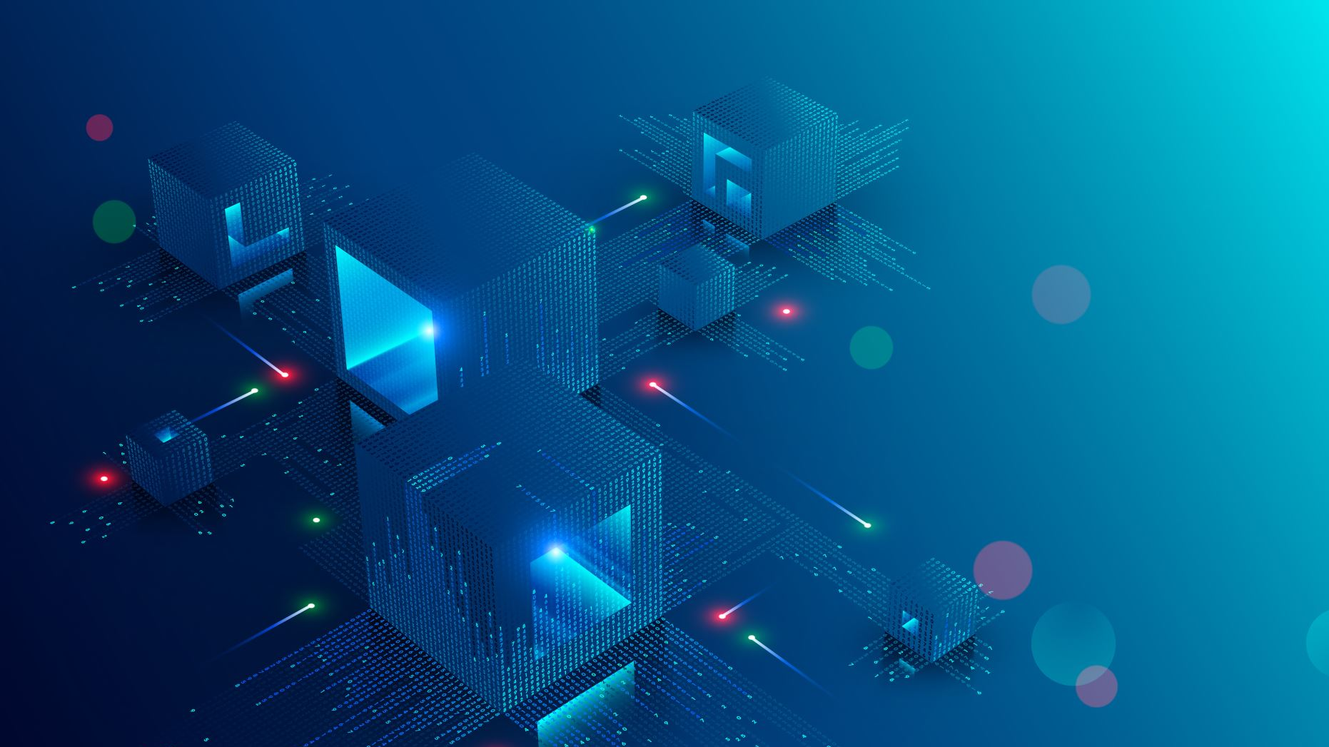
POTENTIAL BENEFITS OF USING BLOCKCHAIN IN REAL ESTATE
Transparency: Blockchain provides a transparent and immutable ledger that allows all participants to access and verify transaction records. This transparency reduces fraud, improves accountability, and enhances trust among buyers, sellers, and other stakeholders.
Security: Blockchain technology ensures the security of real estate transactions through cryptographic techniques. Transactions recorded on the blockchain are tamper-proof and cannot be easily altered, providing a high level of data integrity and protection against fraud.
Efficiency: By automating and streamlining processes through smart contracts, blockchain improves the efficiency of real estate transactions. Smart contracts can automate tasks such as property transfers, verification, and escrow, reducing paperwork, minimizing errors, and accelerating the overall transaction process.
Cost Reduction: Blockchain eliminates the need for intermediaries in real estate transactions, such as brokers and agents. This reduces associated costs and fees, making transactions more cost-effective for buyers and sellers.

Slide 16
POTENTIAL BENEFITS OF USING BLOCKCHAIN IN REAL ESTATE
Trust and Authentication: Blockchain's decentralized and immutable nature ensures the authenticity and integrity of property records. Property ownership, title history, and transaction details can be securely stored on the blockchain, reducing disputes and providing a reliable source of information.
Accessibility to Financing: Blockchain-based platforms can facilitate peer-to-peer lending and crowdfunding, increasing access to financing options for potential buyers. This can benefit individuals with limited credit history or unconventional property types.
Streamlined Property Management: Blockchain enables efficient management of property-related data, including title records, rental agreements, and maintenance history. This streamlines property management processes, reducing administrative burdens and improving overall efficiency.

Slide 17
ARCHITECTURAL FLOW DIAGRAM
The process in the Blockchain based real estate transaction is explained with an architecture diagram. It contains the process of transfer of properties starting from the seller to the buyer. As the Blockchain makes the process transparent every process is visible to everyone. This makes the process impossible to change. SRET includes the integrated designing and planning as well as the execution of various processes. This involves material flow, data flow additionally as money capital flow.

Slide 18
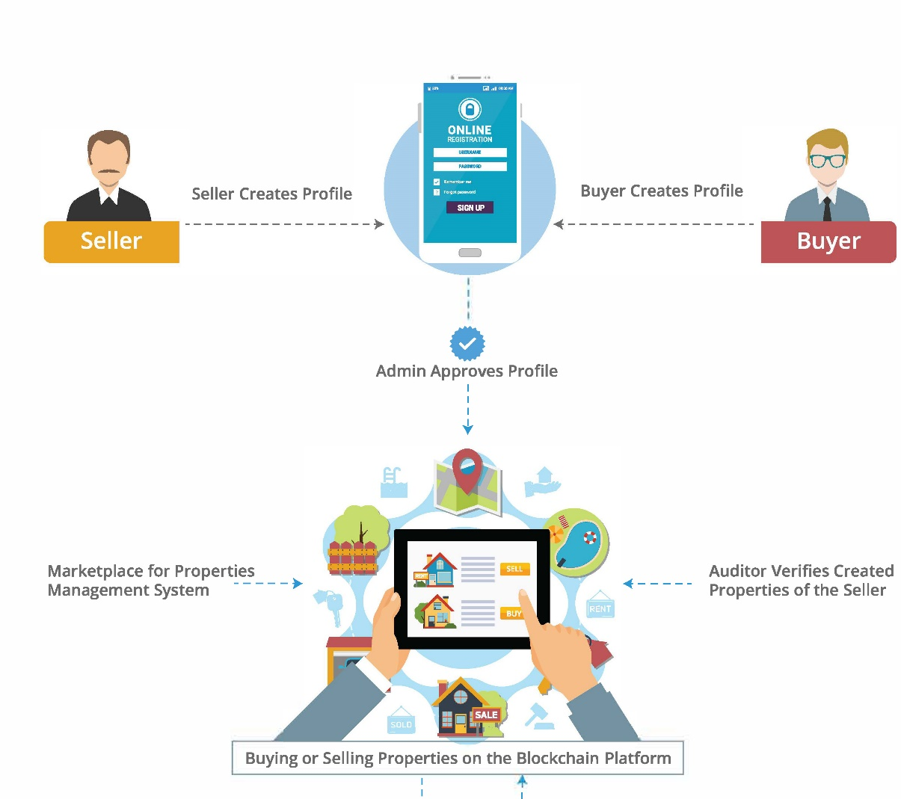

BLOCKCHAIN REAL ESTATE PROCESS

Slide 19
COMMERCIAL REAL ESTATE PROCESS ON BLOCKCHAIN CAN BE AS FOLLOWS:
Step 1: Property Marketplace
Lessor and the lessee will meet at the online marketplace where verified information about the property is available to everyone transparently, including owners details, geo-location, chain of custody, the area covered, and more. The marketplace will be integrated with the government systems to ensure the authenticity of the information.
Step 2: Identity Verification
A separate Blockchain based identity verification solution will be integrated with the marketplace. This may involve third-party verification companies, government agencies, banks, investors, and more, who will verify the identities. The solution will validate the information from multiple sources, such as bank transactions.
Step 3: Immutable Agreements
Once both parties decide to go ahead and enter into the agreement, the terms and conditions of the agreement will be recorded in the Smart Contract.
Step 4: Autonomous Payouts
Based on the T&C stored in the Smart Contract, the lease payout will get credited in the accounts of the lessor. All the data will be recorded on Blockchain with the time-stamp and can be utilized for real-time data analysis.

Slide 20
IMPLEMENTATION
Practical implementation of blockchain in real estate
Necessary steps and components required for successful adoption
Existing blockchain platforms or projects specific to real estate

Slide 21
PRACTICAL IMPLEMENTATION OF BLOCKCHAIN IN REAL ESTATE
Identifying
Identifying relevant data to be recorded on the blockchain.
Choosing
Choosing between consortium or public blockchain.
Implementing
Implementing smart contracts for automated processes.
Integrating
Integrating with existing systems and databases.
Ensuring
Ensuring identity verification for participants.
Establishing
Establishing governance and consensus mechanisms.
Addressing
Addressing scalability and performance challenges.
Ensuring
Ensuring regulatory compliance.
Educating
Educating stakeholders and promoting adoption.
Starting
Starting with pilot projects and iterating based on feedback and experience.

Slide 22
NECESSARY STEPS AND COMPONENTS REQUIRED FOR SUCCESSFUL ADOPTION
Define objectives
Engage stakeholders
Identify use cases
Evaluate technology
Set up infrastructure
Standardize data
Ensure legal compliance
Conduct pilot projects
Focus on user experience and training
Foster collaboration and ecosystem growth
Continuously evaluate and improve.

Slide 23
EXISTING BLOCKCHAIN PLATFORMS OR PROJECTS SPECIFIC TO REAL ESTATE
Propy: Propy is a blockchain-based platform that aims to streamline the process of buying and selling real estate globally. It provides a decentralized title registry and facilitates cross-border transactions through smart contracts, ensuring transparency and efficiency.
Harbor: Harbor is a blockchain platform for tokenizing real estate assets. It allows properties to be divided into digital tokens, enabling fractional ownership and liquidity for investors. Harbor's platform provides compliance with securities regulations and facilitates secondary trading of real estate tokens.
Atlant: Atlant is a blockchain-based real estate platform that enables peer-to-peer property rentals and investments. It utilizes smart contracts to automate rental agreements and tokenizes properties, allowing fractional ownership and easy transfer of ownership.
Relex: Relex is a blockchain platform designed for real estate development projects. It connects developers, investors, and local governments to streamline project funding, ensure transparency, and facilitate efficient investment processes.
Ubitquity: Ubitquity offers a blockchain-based platform for title record management and secure document storage. It aims to improve the accuracy and transparency of property records, reduce fraud, and simplify the title transfer process.

Slide 24
CONCLUSION
In conclusion, the application of blockchain in the real estate sector has the potential to revolutionize the industry by addressing challenges and pain points. Through its transparent, secure, and efficient nature, blockchain can enhance transparency, streamline processes, and improve trust and accountability. The adoption of blockchain in real estate can lead to benefits such as increased transparency, improved security, reduced costs, streamlined transactions, and enhanced accessibility to financing. While there are challenges to overcome and practical implementation considerations, the successful adoption of blockchain in real estate can significantly transform the industry, benefiting buyers, sellers, and other stakeholders involved.

Slide 25
REFERENCES
https://www.fool.com/investing/stock-market/market-sectors/financials/blockchain-stocks/blockchain-applications/
https://consensys.net/blockchain-use-cases/real-estate/
https://www.softermii.com/blog/blockchain-use-cases-in-real-estate-and-benefits-it-brings-for-the-industry
https://entethalliance.org/wp-content/uploads/2019/05/EEA-Real-Estate-SIG-Use-Cases-May-2019.pdf
https://www.irjet.net/archives/V6/i3/IRJET-V6I3217.pdf
https://www.leewayhertz.com/blockchain-real-estate-process/

